Slide 1

Virtual Reality Interfaces for 3D model reconstruction and sharing
Student: Andrei Bunea
Supervisor: Prof. Anthony Steed

Slide 2
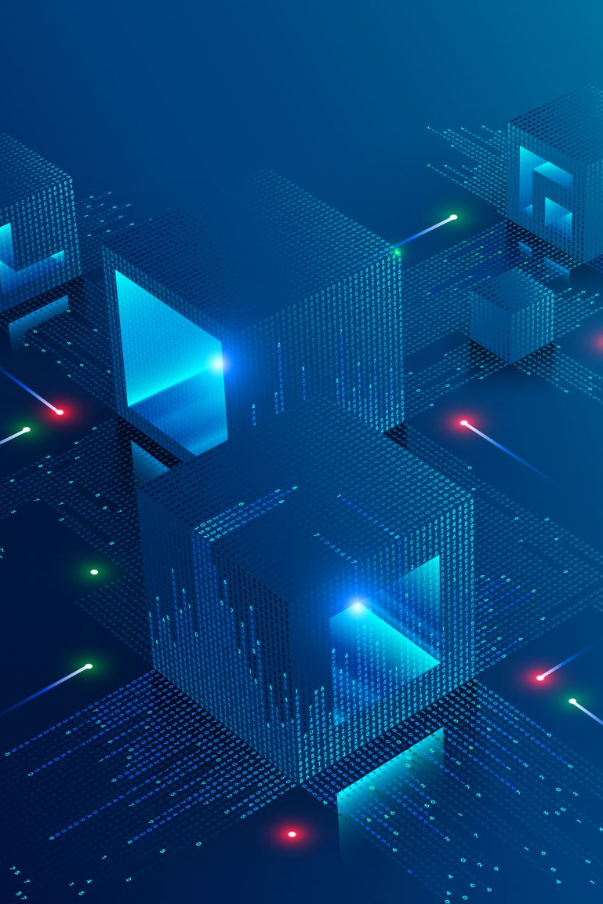
About the project
The project aims to facilitate 3D reconstruction and visualization to users who lack skills in photogrammetry.
What the project offers:
Reliable and easy-to-use 3D reconstruction
Object sharing
Object storing
Virtual visualization inside the web application
Immersive experience for visualization inside the VR application

Slide 3
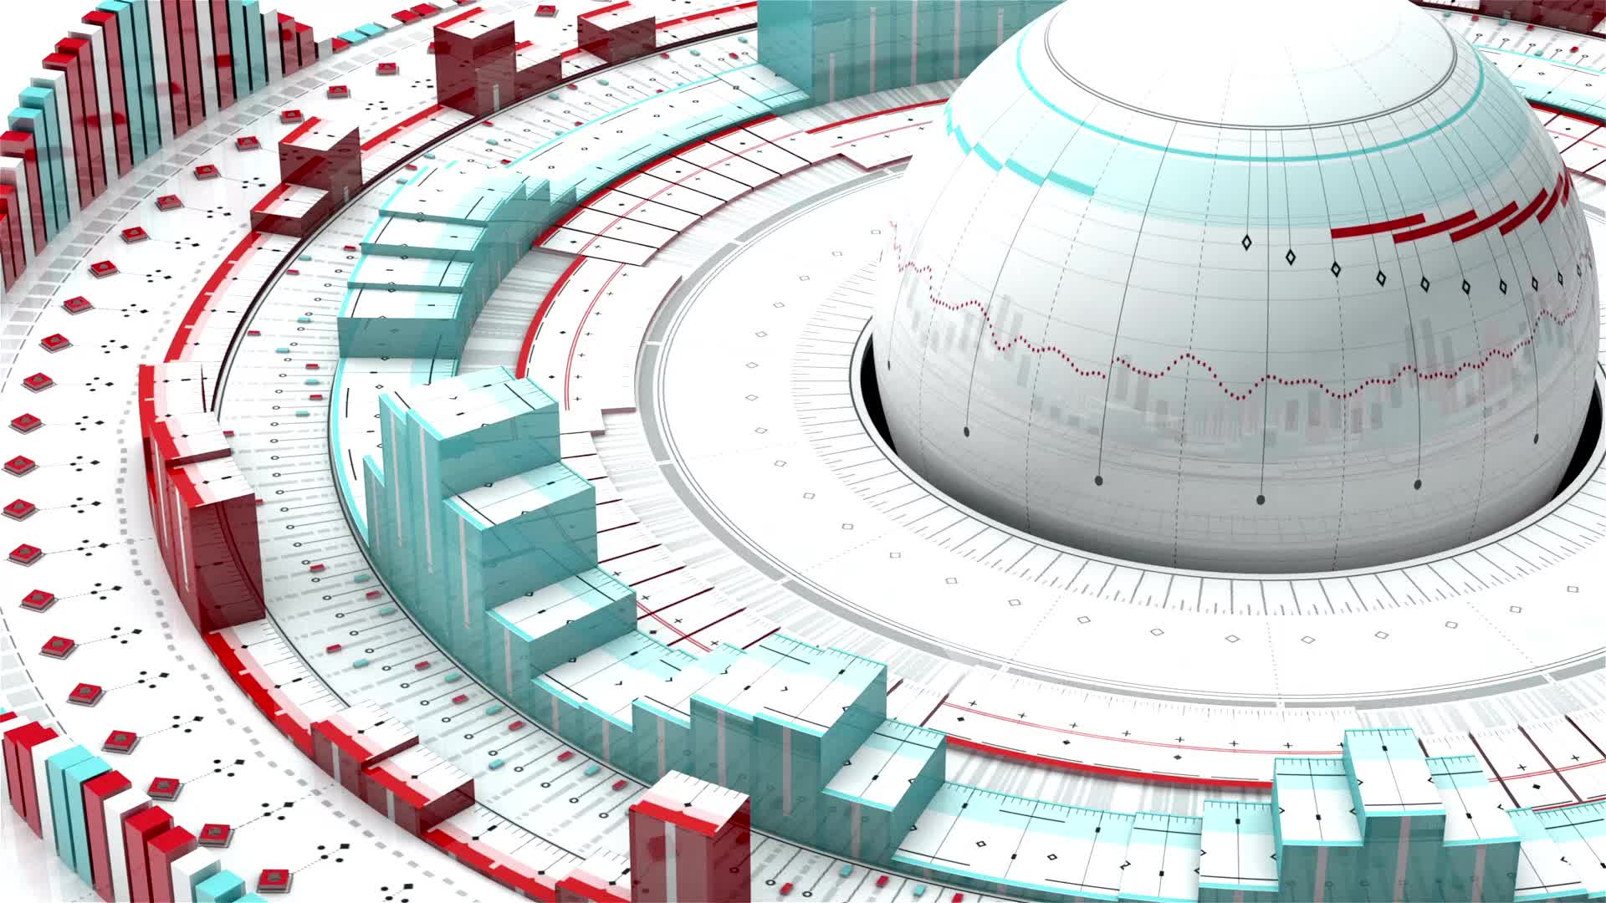
Motivation
Exploring a 3D model inside an immersive virtual environments facilitates a more authentic expertise rather than analysing images.
There are applications for 3D reconstruction, and VR applications can be used to view 3D objects, but there is no platform that combines both concepts.
Providing easy access to 3D reconstruction to users who do not master any reconstruction software.
A tool for collecting virtual scans of real objects.

Slide 4
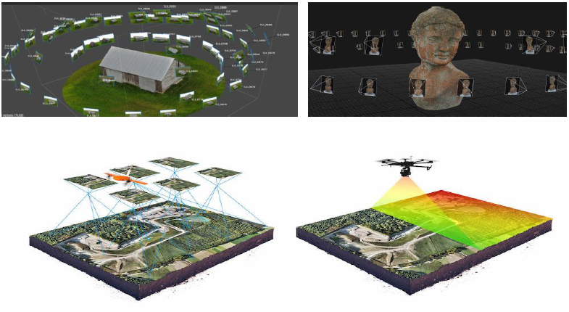
Photogrammetry

Slide 5
Structure-from-Motion
Structure from Motion (SfM) is a process derived from photogrammetry.
SfM incorporates other additional tasks such as estimating the camera position and parameters, being more concerned with capturing relative positions and orientations of images.
Structure from motion is more flexible and automated, as it does not rely on camera calibration and geolocation. Instead, it uses feature tracking across the images to determine the camera parameters.

Slide 6
Model of the forum in Pompeii
SfM in physical geography
The “Relief” tomb in Cerveteri, Italy
3D models of archeological artefacts

Slide 7
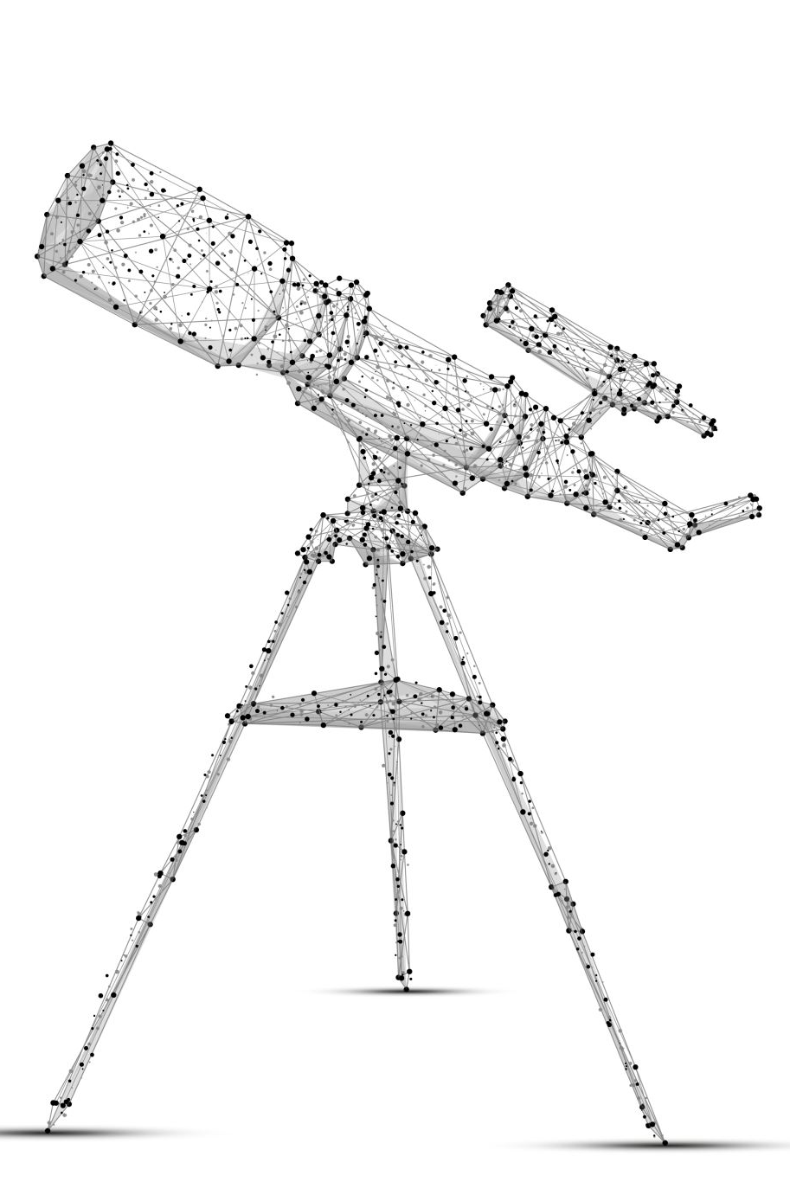
Structure-from-Motion
Feature Detection
Feature Matching
Camera Pose Estimation
Sparse Point Cloud Reconstruction
Bundle Adjustment
Mesh Generation
Texture Mapping

Slide 8
Project structure
Web Application
(Node.JS)
VR Application
(Unity)
3D Reconstruction module
(Bash Script + Meshroom)
Flask Backend
(Python)
Database
(MySQL)

Slide 9
Web Application

Slide 10
Login & Register

Slide 11
Dashboard

Slide 12
Upload for reconstruction

Slide 13
Portfolio

Slide 14
Built-in visualization tool (THREE.js)

Slide 15
Explore

Slide 16
Browse other users’ work

Slide 17
VR Application

Slide 18
VR Portfolio

Slide 19
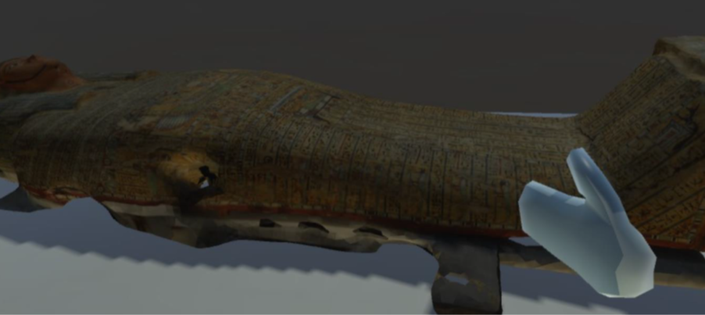
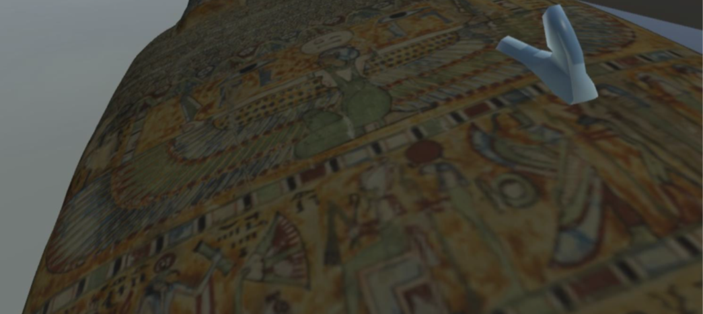
Spawned models

Slide 20
Explore other portfolios

Slide 21
3D models of other users

Slide 22
SfM Pipeline
Gathers information from image datasets to reconstruct 3D models
Python script that handles the execution of Meshroom in command line interface
Defines the parameters, thresholds and algorithms for every step of the process
Automatic, free, open-source and CLI accessible

Slide 23
Reconstruction software comparison

Slide 24
SfM Pipeline (2)
Depth Map
Depth Map Filtering
Meshing
Mesh Filtering
Mesh Decimating
Mesh Resampling
Texturing
Camera initialization
Feature extraction
Image Matching
Feature Matching
Structure from Motion
Dense Scene Preparation

Slide 25
Experiment - Methodology
15 participants
Different levels of expertise
Consent form
Pre-Experience Questionnaire
Web part of the experiment
VR part of the experiment
Post-Experience Questionnaire

Slide 26
Experiment - User feedback
10 out of 15 users were aware of the 3D reconstruction concept
12 out of 15 users have experienced VR headsets before
4/15 moderate complex scenes, 5/15 complex and 6/15 extremely complex
Eg: Coconut, garden gnome, mural, building facades, statues
Majority of textures: plastic, stone, wood, metal
14/15 considered the 3D reconstruction as effective, while 8/15 marked as very effective
13 out of 15 participants experienced reconstruction times under 10mins

Slide 27
Effective results
Very effective results

Slide 28
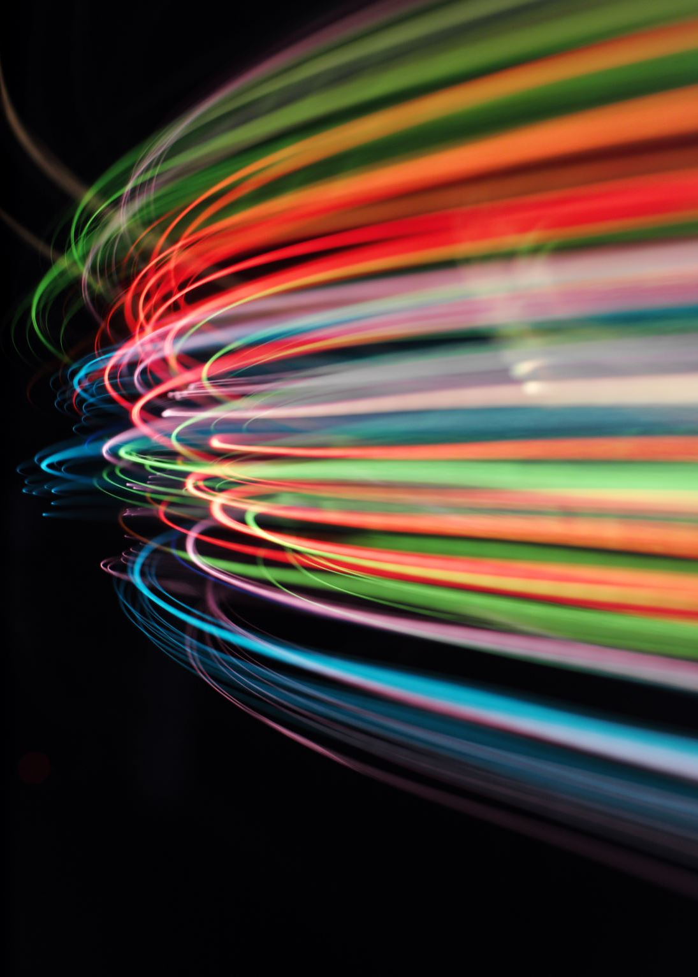
Critical aspects of the dataset
Image quality
Illumination
Capture every angle and detail
Clear images

Slide 29
Experiment - User feedback (2)
All the participants said that the Web and VR applications ran smoothly
13 out of 15 participants marked the VR application as very effective in presenting the scanned objects
14 out of 15 participants assessed the experiment as highly engaging
All the participants labelled the applications as highly appealing
Nothing unusual happened
The details of the virtual objects, their authenticity and the virtual scene setup made the users feel immersed

Slide 30
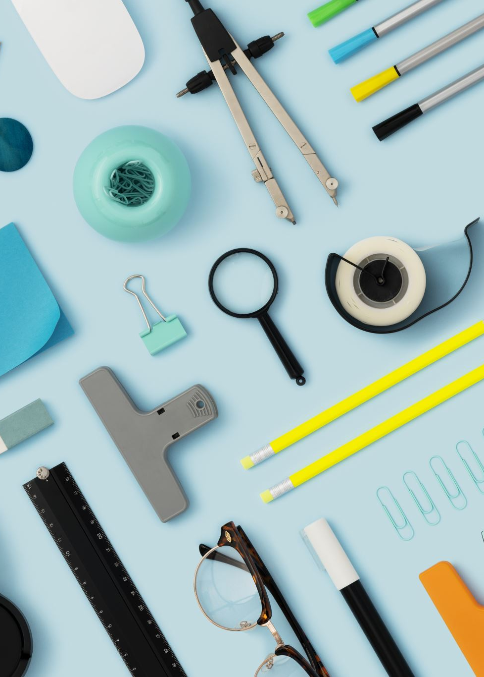
Use cases
Recording objects for personal projects
Virtual Museum
Education tool
Collecting memories
E-commerce

Slide 31
Future Work
Hardware upgrade to bolster the reconstruction performance
Networking. Gather multiple users in the same virtual scene

Slide 32
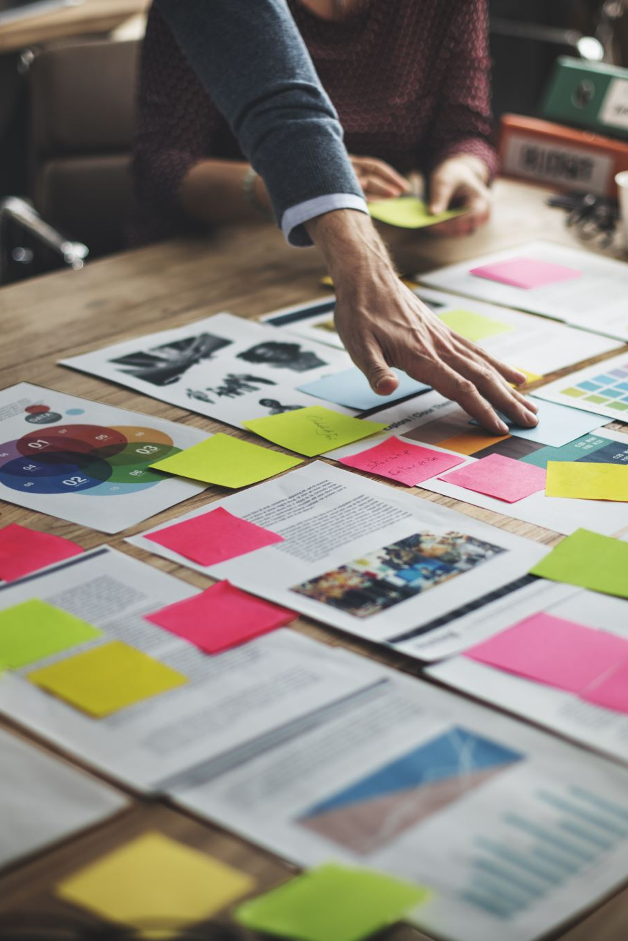
Conclusion
Engaging experience that fulfils the creative needs
Manages the whole reconstruction process, from creating an account and uploading the images to visualizing the results
The design is highly appealing, the process runs smoothly, and it is easy to use.
Effective reconstruction
Immersive experience

Slide 33
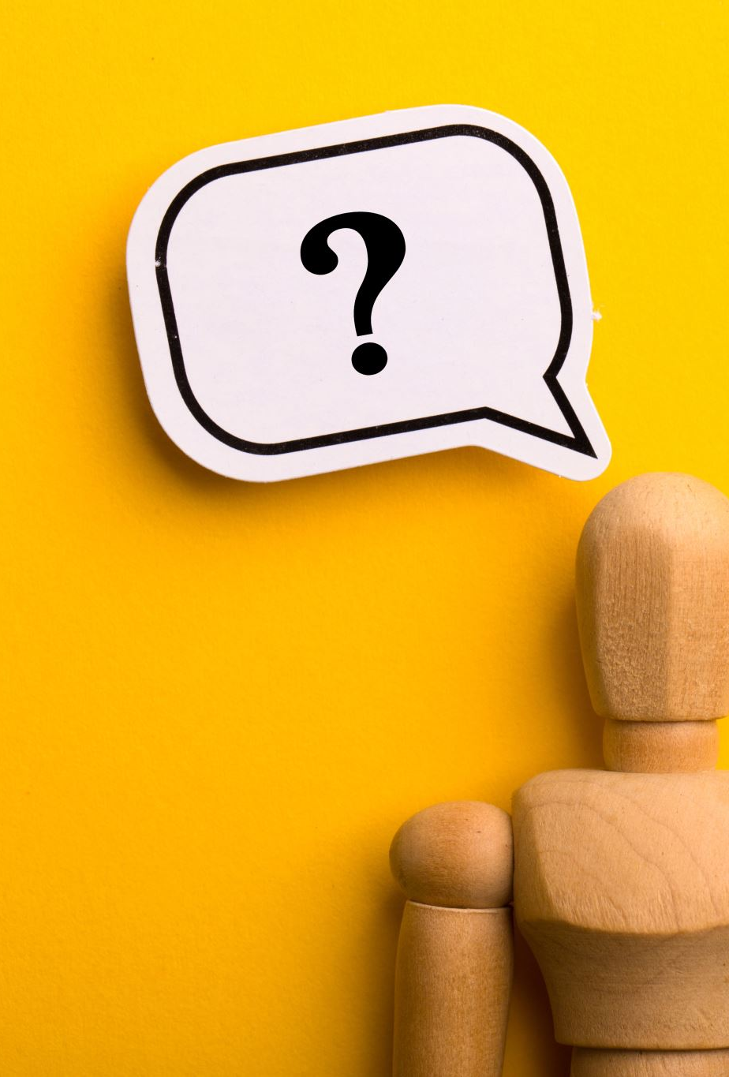
Thank you for your attention!

